Slide 1

VEHICLE RENTAL MANAGEMENT SYSTEM
DBMS Cornerstone Project
PRESENTED BY:
[K. N M ABHIRAM CHANDU]
[K.SAI SAMPATH]
[K.SURYA PUSHKAR]
[K.J V AVINASH ]
DEPARTMENT: COMPUTER SCIENCE AND ENGINEERING
YEAR: II B.TECH
SUBJECT: DATABASE MANAGEMENT SYSTEMS
FACULTY: [VYDEHI MAM]
03-10-2026
DBMS
1

Slide 2
PROBLEM STATEMENT:
Managing vehicle rentals manually can be time-consuming and difficult.
Maintaining customer and vehicle records manually may lead to errors.
Checking vehicle availability for a particular period can be difficult.
Managing bookings, rental details, payments, and returns requires proper record keeping.
Searching and updating rental information manually takes more time.
There is a need for a centralized database to store and manage all rental information efficiently.
PROPOSED SOLUTION:
The Vehicle Rental Management System provides a centralized database to manage customers, vehicles, rentals, payments, and returns in an organized and efficient manner.
03-10-2026
DBMS
2

Slide 3
WHY IS THE SYSTEM NEEDED?
To reduce manual work in vehicle rental management.
To maintain customer and vehicle information in one place.
To quickly check vehicle availability.
To manage rental bookings efficiently.
To maintain accurate payment and return records.
To reduce data duplication and human errors.
To provide faster access to rental information.
03-10-2026
DBMS
3

Slide 4
OBJECTIVES:
The main objectives of the Vehicle Rental Management System are:
To store and manage customer details securely.
To maintain complete information about available vehicles.
To manage vehicle booking and rental details.
To track vehicle availability and rental status.
To maintain payment and return information.
To reduce manual work and data entry errors.
To provide quick and organized access to rental records.
03-10-2026
DBMS
4

Slide 5
FUNCTIONAL REQUIREMENTS:
The system should be able to:
Register and manage customer information.
Add, update, delete, and view vehicle details.
Display the availability status of vehicles.
Create and manage vehicle rental bookings.
Record rental start date and expected return date.
Record payment details for rentals.
Record vehicle return information.
Update the vehicle status after booking and return.
Search and retrieve customer, vehicle, and rental records.
Generate rental-related information when required.
03-10-2026
DBMS
5

Slide 6
NON-FUNCTIONAL REQUIREMENTS:
The system should provide:
Security: Protect customer and rental information from unauthorized access.
Performance: Retrieve and update records quickly.
Reliability: Maintain accurate and consistent rental data.
Usability: Provide a simple and user-friendly interface.
Scalability: Allow the database to handle more customers and vehicles in the future.
Data Integrity: Ensure that stored information remains accurate and consistent.
Availability: Make the system available whenever rental information is required.
03-10-2026
DBMS
6

Slide 7
END USERS
1. ADMINISTRATOR
Manages the complete system.
Adds and updates vehicle information.
Manages customer and rental records.
Monitors payments and returns.
2. RENTAL STAFF
Registers customers.
Creates rental bookings.
Checks vehicle availability.
Records vehicle returns and payments.
3. CUSTOMER
Provides personal details for registration.
Views available vehicles.
Requests/bookings vehicles.
Provides rental and return information.
03-10-2026
DBMS
7

Slide 8
ER DESIGN:
The Entity-Relationship (ER) model represents the structure of the Vehicle Rental Management System.
It identifies:
Entities – Objects involved in the system.
Attributes – Properties that describe each entity.
Primary Keys – Uniquely identify each record.
Relationships – Show how entities are connected.
Cardinality – Defines how many records of one entity can be associated with another entity.
03-10-2026
DBMS
8

Slide 9
MAIN ENTITIES:
Customer
Vehicle
Vehicle Type
Rental
Payment
Return
Staff / Administrator
03-10-2026
DBMS
9

Slide 10
ENTITIES AND ATTRIBUTES:
Entity | Primary Key | Important Attributes
Customer | Customer_ID | Name, Phone, Email, Address
Vehicle | Vehicle_ID | Vehicle_Number, Model, Brand, Year, Status
Vehicle Type | Type_ID | Type_Name, Description
Rental | Rental_ID | Rental_Date, Start_Date, End_Date, Status
Payment | Payment_ID | Amount, Payment_Date, Payment_Method
Return | Return_ID | Return_Date, Condition, Late_Fee
Staff | Staff_ID | Name, Phone, Email, Role
03-10-2026
DBMS
10

Slide 11
ENTITY JUSTIFICATION:
Customer
Stores information about people who rent vehicles.
Vehicle
Stores details of vehicles available for rental.
Vehicle Type
Classifies vehicles according to their type, such as car, bike, SUV, etc.
Rental
Stores information about vehicle booking and rental periods.
Payment
Maintains payment information related to a rental.
Return
Stores details about the return of a rented vehicle.
Staff
Stores information about employees who manage rental activities.
03-10-2026
DBMS
11

Slide 12
RELATIONSHIPS:
A relationship tells us how two entities are connected to each other.
A Customer makes a Rental.
A Vehicle is assigned to a Rental.
A Vehicle Type classifies one or more Vehicles.
A Rental has associated Payment information.
A Rental has a Return record when the vehicle is returned.
A Staff member manages Rental activities.
03-10-2026
DBMS
12

Slide 13
CARDINALITY:
Customer — Rental
1 : M
One customer can make many rentals, while each rental belongs to one customer.
Vehicle Type — Vehicle
1 : M
One vehicle type can contain many vehicles, while each vehicle belongs to one vehicle type.
Vehicle — Rental
1 : M
One vehicle can be rented many times over different periods, while each rental is associated with one vehicle.
Rental — Payment
1 : 1
Each rental has one payment record in the basic system design.
Rental — Return
1 : 1
Each completed rental has one return record.
03-10-2026
DBMS
13

Slide 14
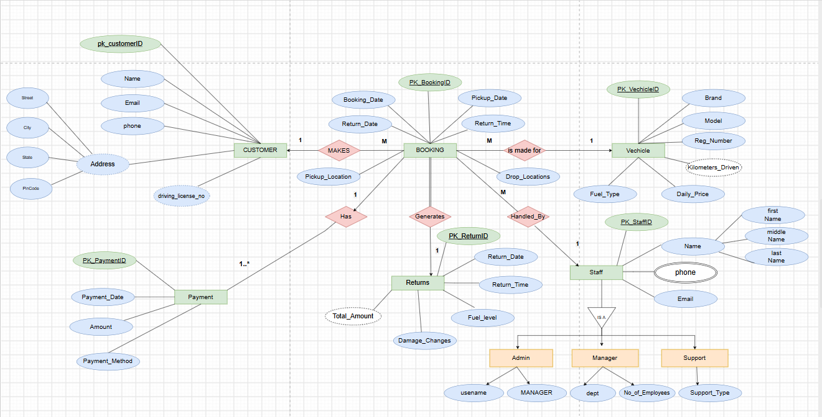
ER-DIAGRAM
03-10-2026
DBMS
14

Slide 15
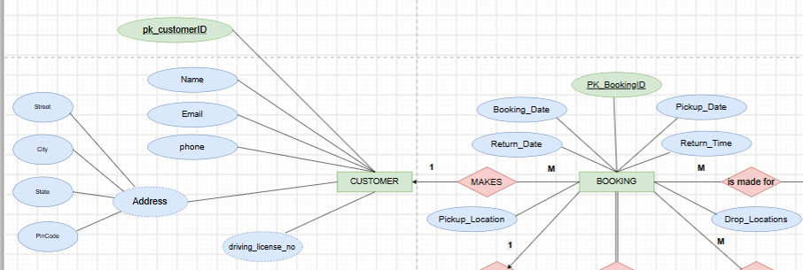
CUSTOMER TABLE
CREATE TABLE CUSTOMER
(
CUSTOMER_ID NUMBER(5) PRIMARY KEY,
NAME VARCHAR2(50) NOT NULL,
EMAIL VARCHAR2(80) UNIQUE,
PHONE VARCHAR2(15),
STREET VARCHAR2(50),
CITY VARCHAR2(30),
STATE VARCHAR2(30),
PINCODE VARCHAR2(10),
DRIVING_LICENSE_NO VARCHAR2(25) UNIQUE
);
03-10-2026
DBMS
15

Slide 16
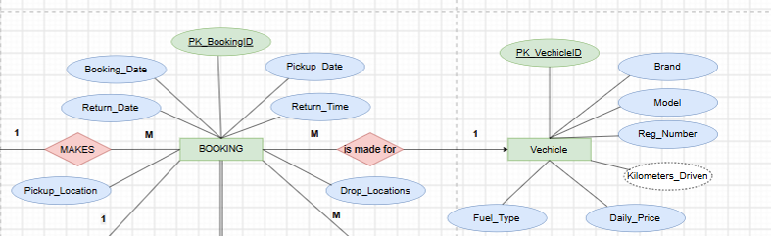
VEHICLE TABLE
CREATE TABLE VEHICLE
(
VEHICLE_ID NUMBER(5) PRIMARY KEY,
BRAND VARCHAR2(30) NOT NULL,
MODEL VARCHAR2(30) NOT NULL,
REG_NUMBER VARCHAR2(20) UNIQUE NOT NULL,
KILOMETERS_DRIVEN NUMBER(8),
FUEL_TYPE VARCHAR2(15),
DAILY_PRICE NUMBER(10,2) NOT NULL
);
03-10-2026
DBMS
16

Slide 17
BOOKING TABLE
CREATE TABLE BOOKING
(
BOOKING_ID NUMBER(5) PRIMARY KEY,
CUSTOMER_ID NUMBER(5) NOT NULL,
VEHICLE_ID NUMBER(5) NOT NULL,
STAFF_ID NUMBER(5),
BOOKING_DATE DATE NOT NULL,
PICKUP_DATE DATE NOT NULL,
RETURN_DATE DATE NOT NULL,
RETURN_TIME VARCHAR2(10),
PICKUP_LOCATION VARCHAR2(50),
DROP_LOCATION VARCHAR2(50),
CONSTRAINT FK_BOOKING_CUSTOMER
FOREIGN KEY (CUSTOMER_ID)
REFERENCES CUSTOMER(CUSTOMER_ID),
CONSTRAINT FK_BOOKING_VEHICLE
FOREIGN KEY (VEHICLE_ID)
REFERENCES VEHICLE(VEHICLE_ID),
CONSTRAINT FK_BOOKING_STAFF
FOREIGN KEY (STAFF_ID)
REFERENCES STAFF(STAFF_ID)
);
03-10-2026
DBMS
17

Slide 18
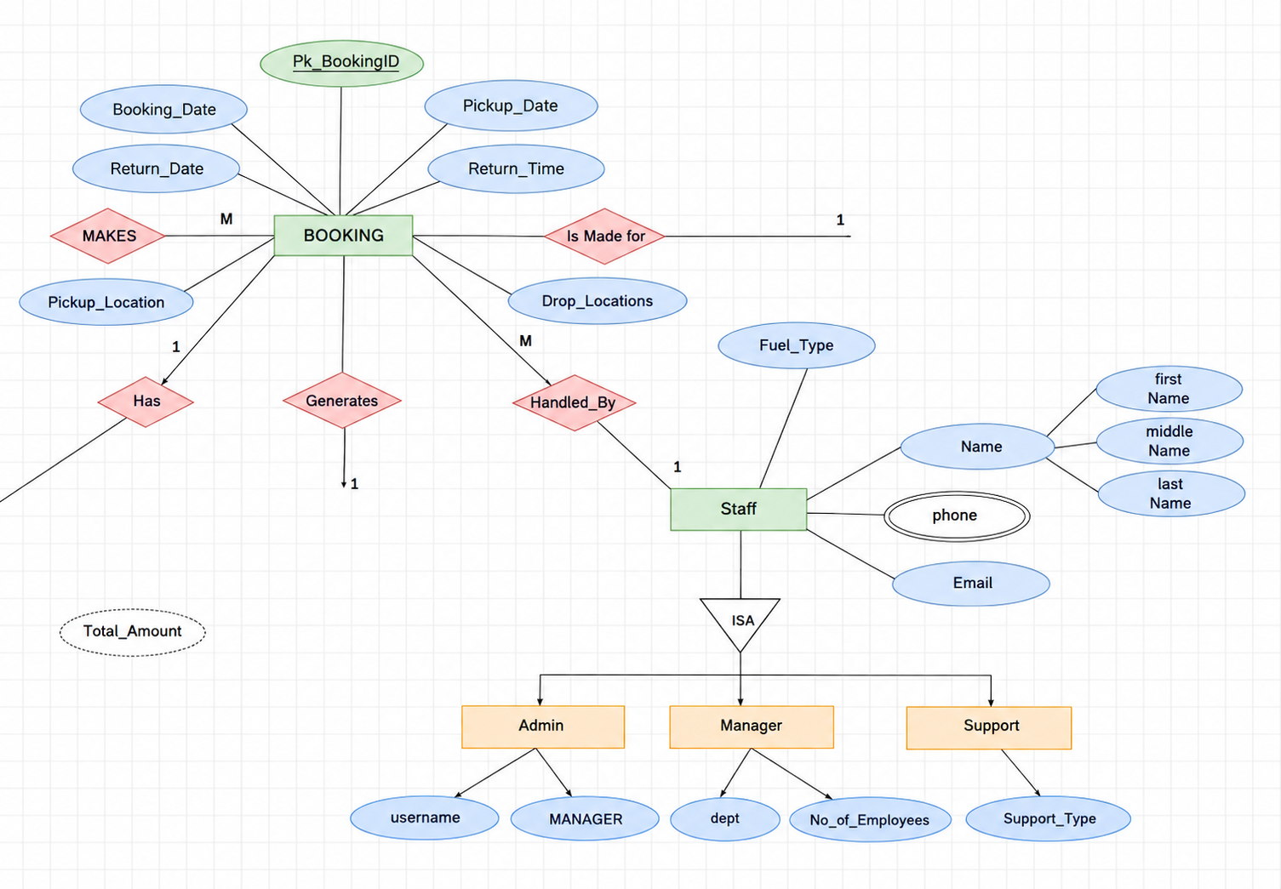
STAFF TABLE
CREATE TABLE STAFF
(
STAFF_ID NUMBER(5) PRIMARY KEY,
FIRST_NAME VARCHAR2(25) NOT NULL,
MIDDLE_NAME VARCHAR2(25),
LAST_NAME VARCHAR2(25) NOT NULL,
PHONE VARCHAR2(15),
EMAIL VARCHAR2(80) UNIQUE
);
03-10-2026
DBMS
18

Slide 19
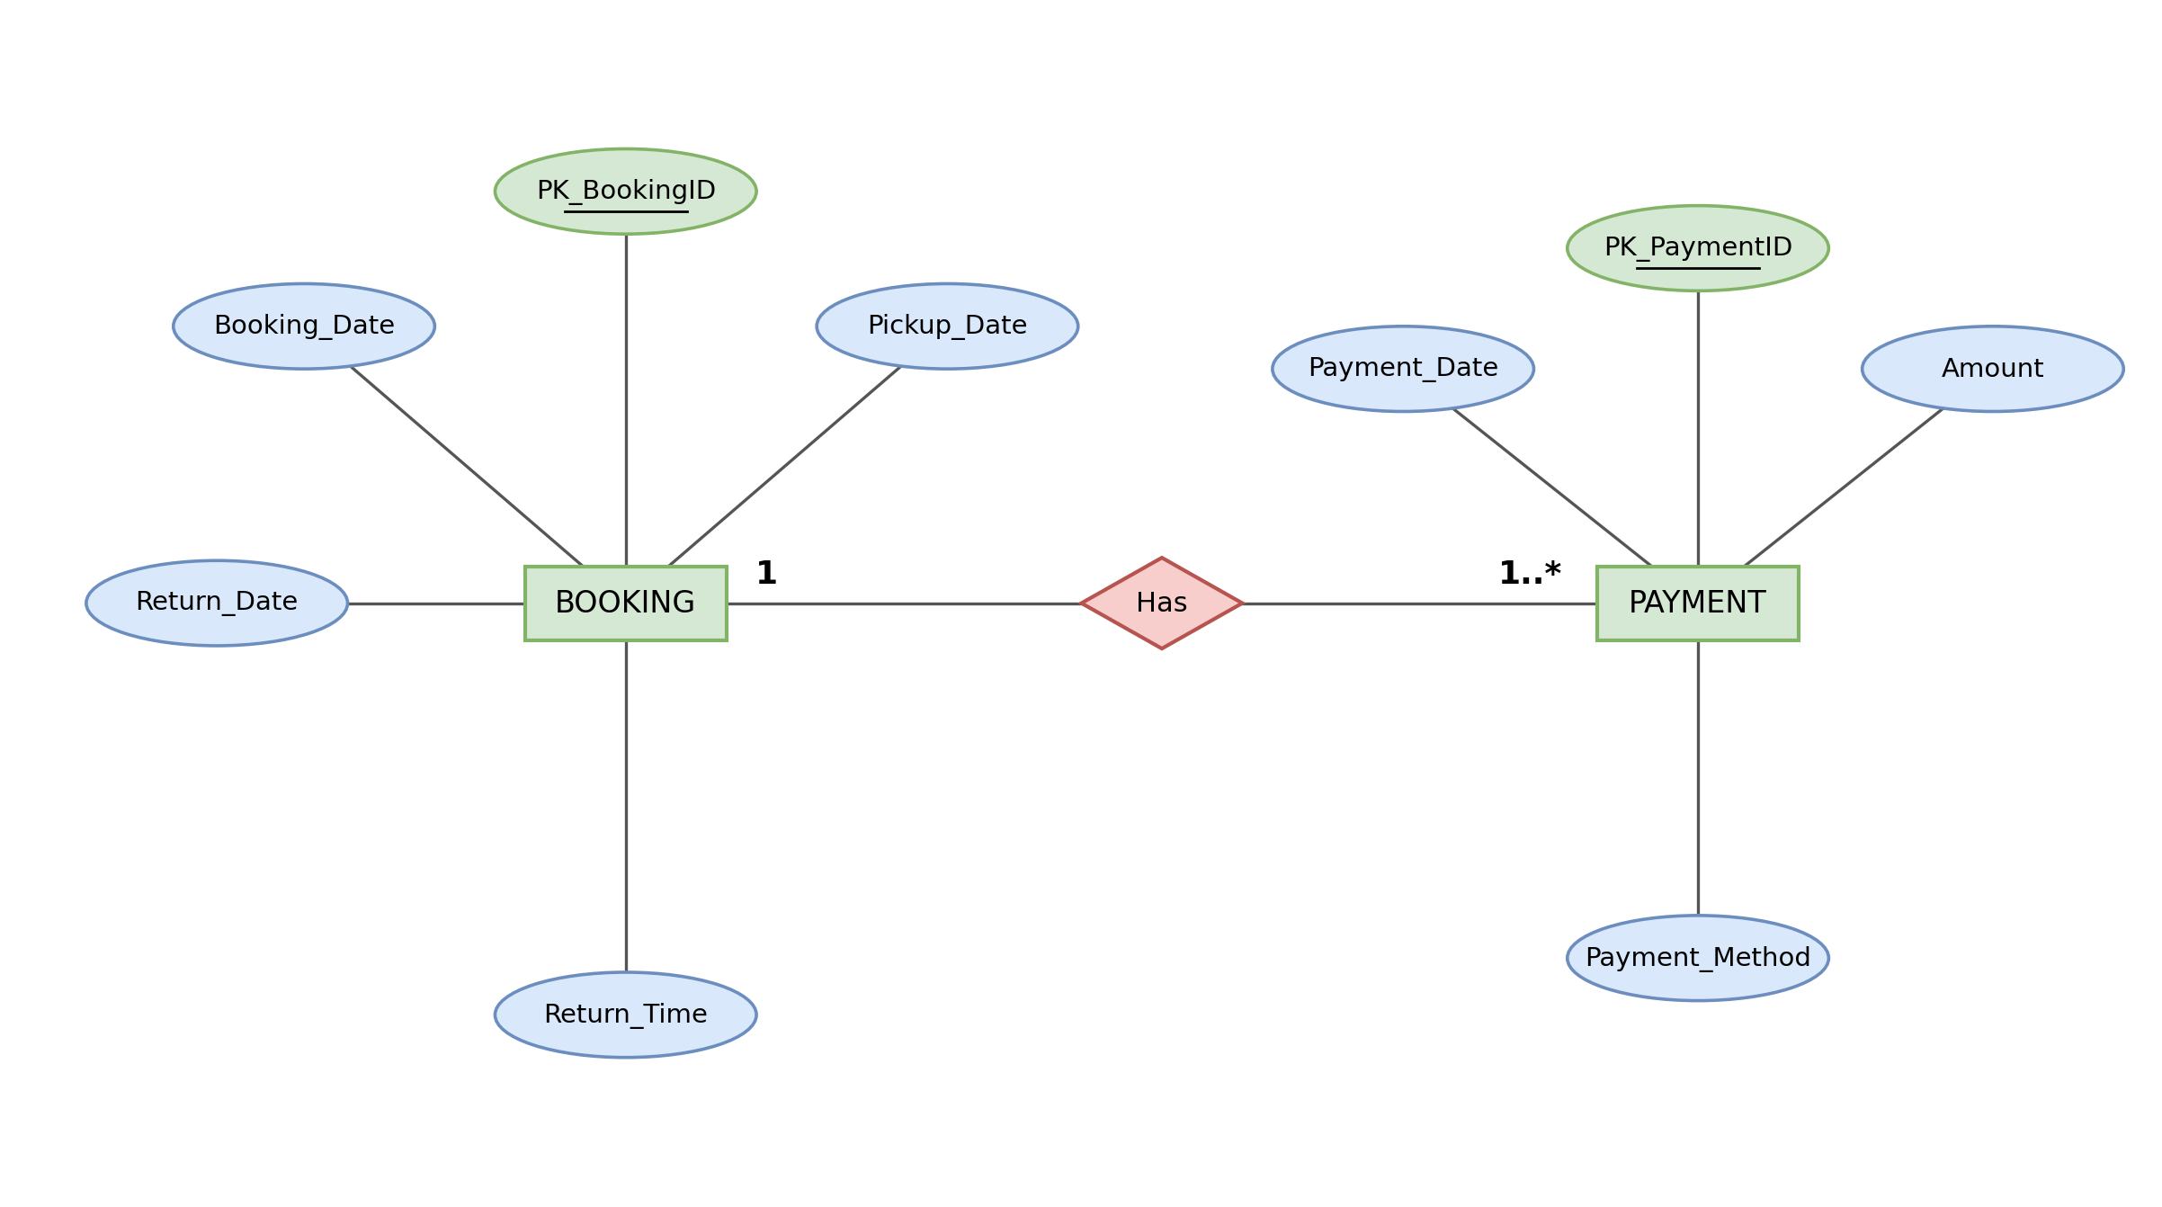
PAYMENT TABLE
CREATE TABLE PAYMENT
(
PAYMENT_ID NUMBER(5) PRIMARY KEY,
BOOKING_ID NUMBER(5) NOT NULL,
PAYMENT_DATE DATE NOT NULL,
AMOUNT NUMBER(10,2) NOT NULL,
PAYMENT_METHOD VARCHAR2(20),
CONSTRAINT FK_PAYMENT_BOOKING
FOREIGN KEY (BOOKING_ID)
REFERENCES BOOKING(BOOKING_ID)
);
03-10-2026
DBMS
19

Slide 20
RETURNS TABLE
CREATE TABLE RETURNS
(
RETURN_ID NUMBER(5) PRIMARY KEY,
BOOKING_ID NUMBER(5) NOT NULL,
RETURN_DATE DATE NOT NULL,
RETURN_TIME VARCHAR2(10),
FUEL_LEVEL VARCHAR2(20),
DAMAGE_CHARGES NUMBER(10,2),
CONSTRAINT FK_RETURNS_BOOKING
FOREIGN KEY (BOOKING_ID)
REFERENCES BOOKING(BOOKING_ID)
);
03-10-2026
DBMS
20

Slide 21
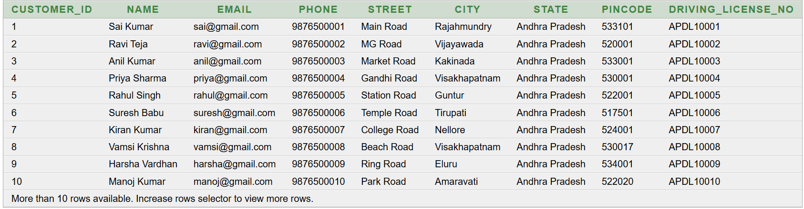
SELECT * FROM CUSTOMER;
03-10-2026
DBMS
21

Slide 22
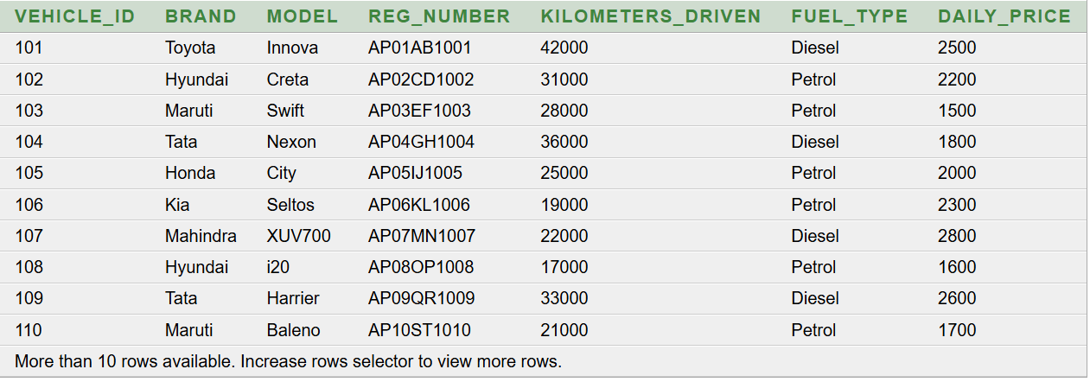
SELECT * FROM VEHICLE;
03-10-2026
DBMS
22

Slide 23
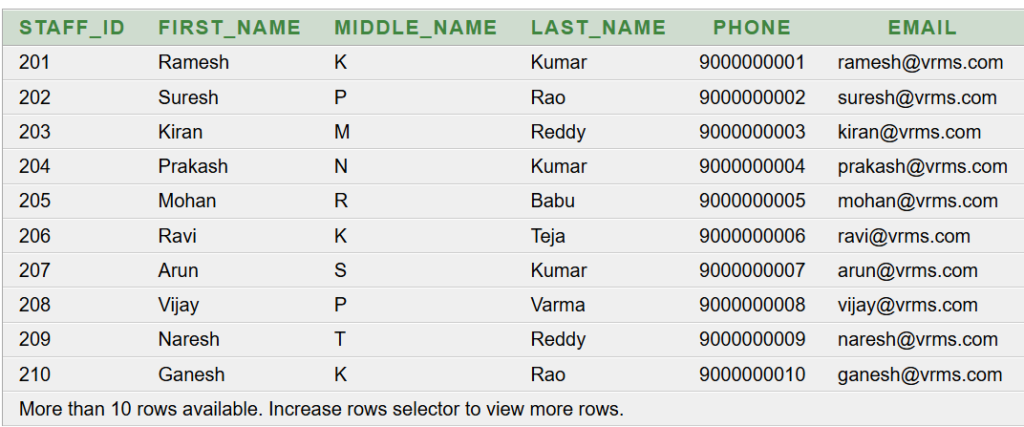
SELECT * FROM STAFF;
03-10-2026
DBMS
23

Slide 24
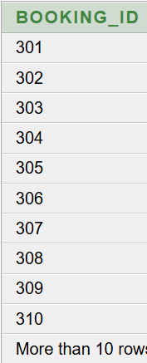
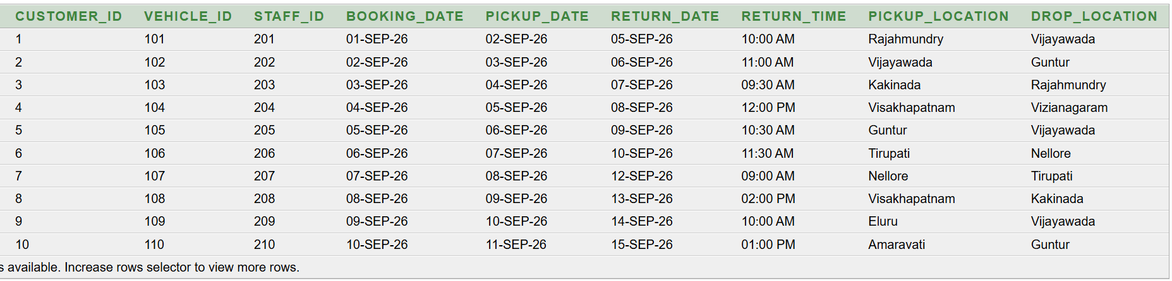
SELECT * FROM BOOKING;
03-10-2026
DBMS
24

Slide 25
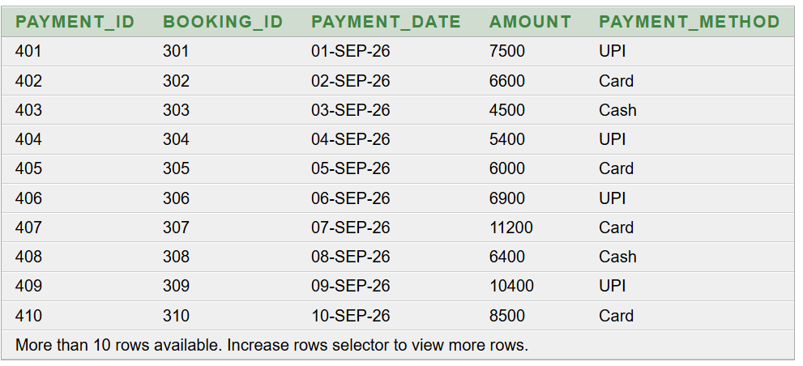
SELECT * FROM PAYMENT
03-10-2026
DBMS
25

Slide 26
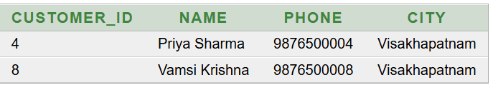
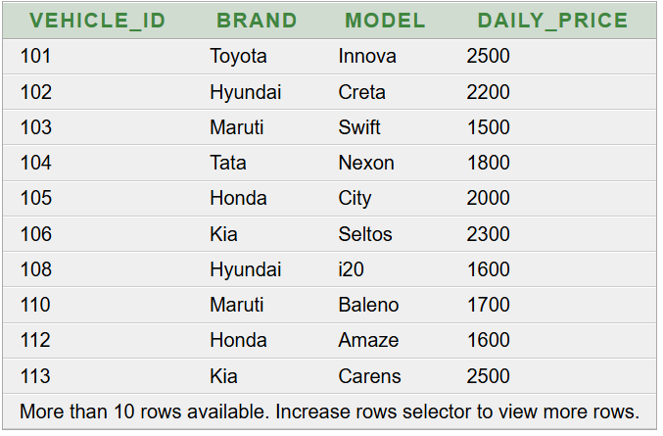
QUERIES
Basic Query 1 — Display customers from Visakhapatnam
SELECT CUSTOMER_ID, NAME, PHONE, CITY
FROM CUSTOMER
WHERE CITY = 'Visakhapatnam';
Basic Query 2 — Display vehicles with daily price between 1500 and 2500
SELECT VEHICLE_ID, BRAND, MODEL, DAILY_PRICE
FROM VEHICLE
WHERE DAILY_PRICE BETWEEN 1500 AND 2500;
03-10-2026
DBMS
26

Slide 27
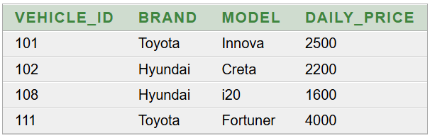
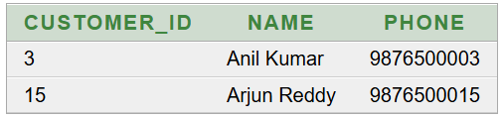
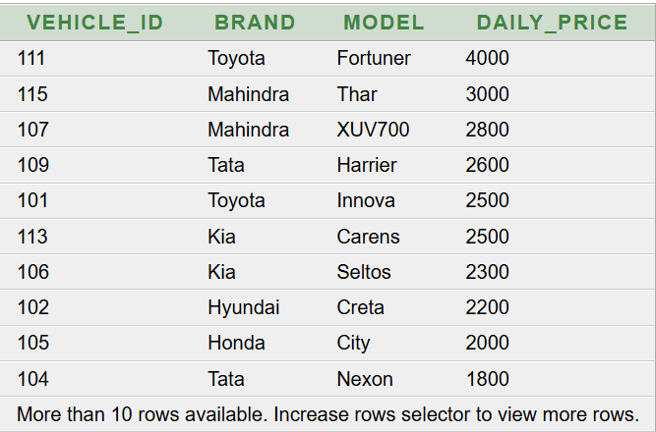
Basic Query 3 — Display vehicles of Toyota or Hyundai brand
SELECT VEHICLE_ID, BRAND, MODEL, DAILY_PRICE
FROM VEHICLE
WHERE BRAND IN ('Toyota', 'Hyundai');
Basic Query 4 — Display customers whose names start with 'A'
SELECT CUSTOMER_ID, NAME, PHONE
FROM CUSTOMER
WHERE NAME LIKE 'A%';
Basic Query 5 — Display vehicles in descending order of daily price
SELECT VEHICLE_ID, BRAND, MODEL, DAILY_PRICE
FROM VEHICLE
ORDER BY DAILY_PRICE DESC;
03-10-2026
DBMS
27

Slide 28
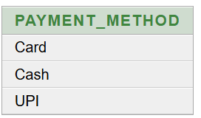
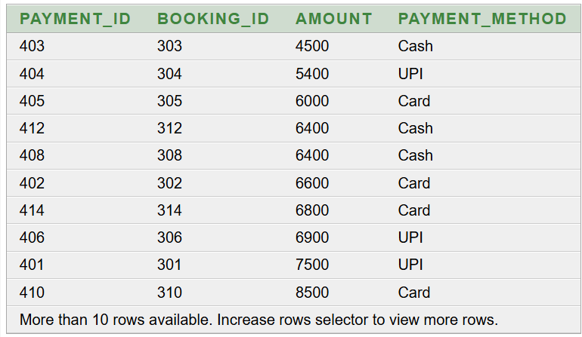
Basic Query 6 — Display different payment methods
SELECT DISTINCT PAYMENT_METHOD
FROM PAYMENT;
Basic Query 7 — Display payment details in ascending order of amount
SELECT PAYMENT_ID, BOOKING_ID, AMOUNT, PAYMENT_METHOD
FROM PAYMENT
ORDER BY AMOUNT ASC;
03-10-2026
DBMS
28

Slide 29
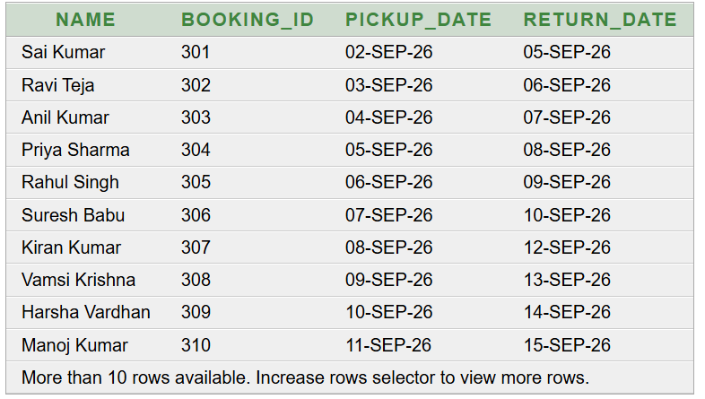
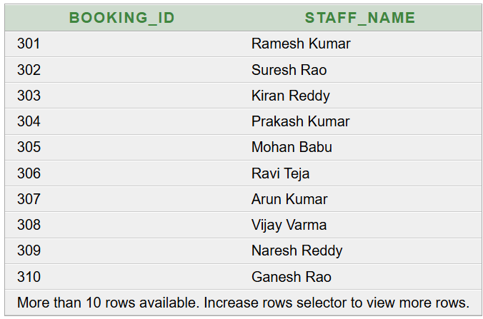
Advanced Query 1 — Customer and booking details
SELECT
C.NAME,
B.BOOKING_ID,
B.PICKUP_DATE,
B.RETURN_DATE
FROM CUSTOMER C
JOIN BOOKING B
ON C.CUSTOMER_ID = B.CUSTOMER_ID;
Advanced Query 2 — Booking handled by staff
SELECT
B.BOOKING_ID,
S.FIRST_NAME || ' ' || S.LAST_NAME AS STAFF_NAME
FROM BOOKING B
JOIN STAFF S
ON B.STAFF_ID = S.STAFF_ID;
03-10-2026
DBMS
29

Slide 30
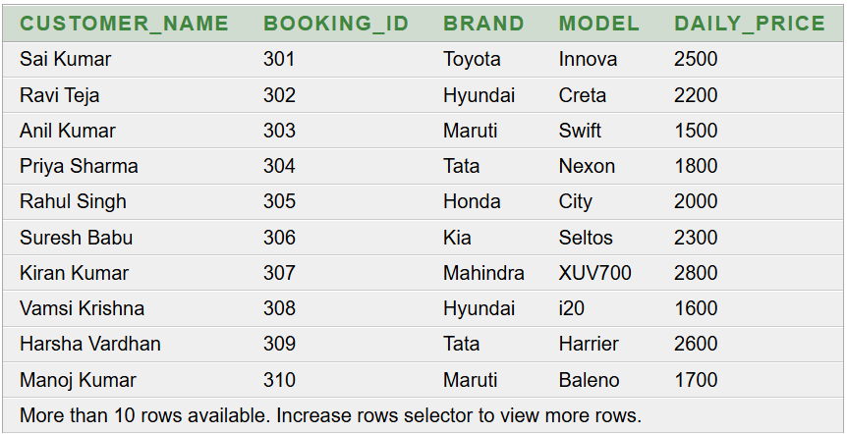
Advanced Query 3— Customer, booking and vehicle details
SELECT
C.NAME AS CUSTOMER_NAME,
B.BOOKING_ID,
V.BRAND,
V.MODEL,
V.DAILY_PRICE
FROM CUSTOMER C
JOIN BOOKING B
ON C.CUSTOMER_ID = B.CUSTOMER_ID
JOIN VEHICLE V
ON B.VEHICLE_ID = V.VEHICLE_ID;
03-10-2026
DBMS
30

Slide 31
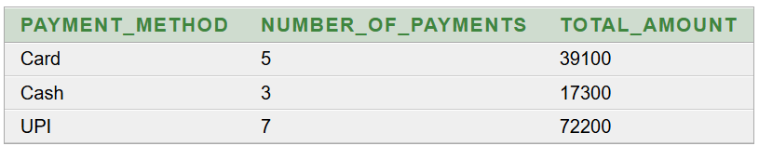
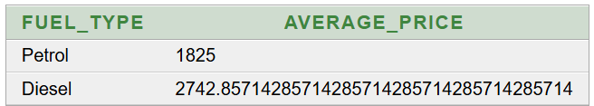
Advanced Query 4 — Total payment by payment method
SELECT
PAYMENT_METHOD,
COUNT(*) AS NUMBER_OF_PAYMENTS,
SUM(AMOUNT) AS TOTAL_AMOUNT
FROM PAYMENT
GROUP BY PAYMENT_METHOD;
Advanced Query 5 — Average vehicle price by fuel type
SELECT
FUEL_TYPE,
AVG(DAILY_PRICE) AS AVERAGE_PRICE
FROM VEHICLE
GROUP BY FUEL_TYPE;
03-10-2026
DBMS
31

Slide 32
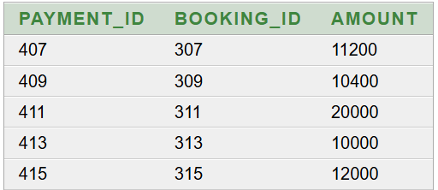
Advanced Query 6 — Payment amount greater than average payment
SELECT
PAYMENT_ID,
BOOKING_ID,
AMOUNT
FROM PAYMENT
WHERE AMOUNT > (
SELECT AVG(AMOUNT)
FROM PAYMENT
);
03-10-2026
DBMS
32

Slide 33
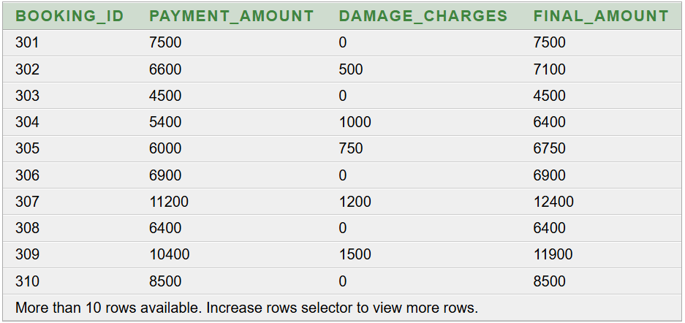
Advanced Query 7 — Booking payment and damage charges
SELECT
B.BOOKING_ID,
P.AMOUNT AS PAYMENT_AMOUNT,
R.DAMAGE_CHARGES,
P.AMOUNT + R.DAMAGE_CHARGES AS FINAL_AMOUNT
FROM BOOKING B
JOIN PAYMENT P
ON B.BOOKING_ID = P.BOOKING_ID
JOIN RETURNS R
ON B.BOOKING_ID = R.BOOKING_ID;
03-10-2026
DBMS
33

Slide 34
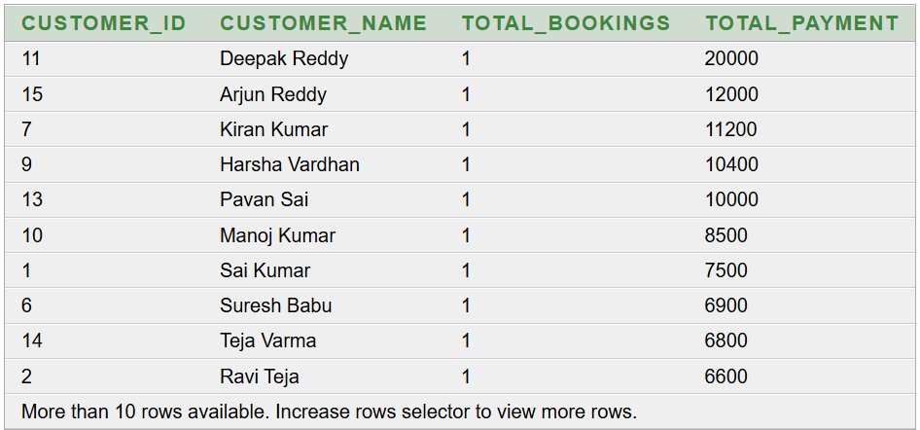
Advanced Query 8— Find customers who have made bookings and show their total payment amount
SELECT
C.CUSTOMER_ID,
C.NAME AS CUSTOMER_NAME,
COUNT(B.BOOKING_ID) AS TOTAL_BOOKINGS,
SUM(P.AMOUNT) AS TOTAL_PAYMENT
FROM CUSTOMER C
JOIN BOOKING B
ON C.CUSTOMER_ID = B.CUSTOMER_ID
JOIN PAYMENT P
ON B.BOOKING_ID = P.BOOKING_ID
GROUP BY C.CUSTOMER_ID, C.NAME
ORDER BY TOTAL_PAYMENT DESC;
03-10-2026
DBMS
34

Slide 35
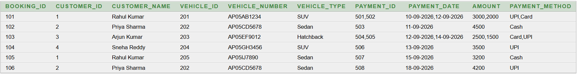
UNNORMALISED DATA
03-10-2026
DBMS
35

Slide 36
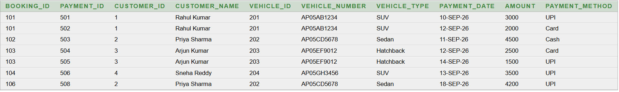
FIRST NORMAL FORM — 1NF
03-10-2026
DBMS
36

Slide 37
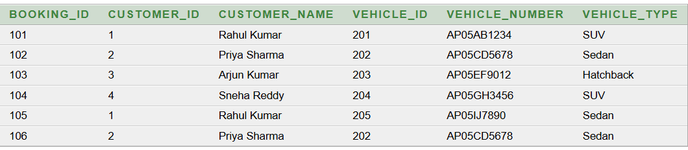
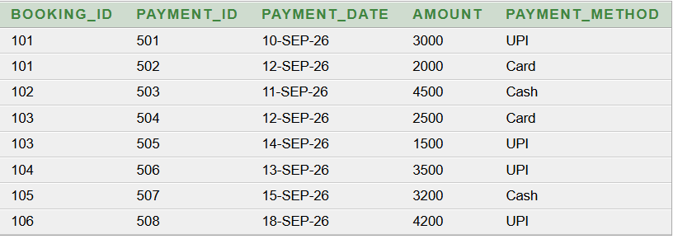
2NF--(NORMAL FORM)
03-10-2026
DBMS
37

Slide 38
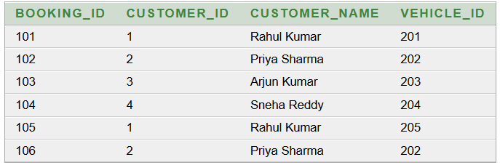
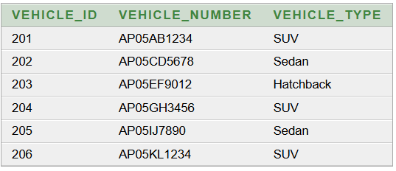
3NF(NORMAL FORM)
03-10-2026
DBMS
38

Slide 39
1NF--(NORMAL FORM)
PRIMARY KEY(Booking_ID)
03-10-2026
DBMS
39

Slide 40
2NF--(NORMAL FORM)
03-10-2026
DBMS
40

Slide 41
03-10-2026
DBMS
41

Slide 42
CONCLUSION:
The Vehicle Rental Management System provides a structured way to manage vehicle rental operations using a database.
It centralizes customer, vehicle, rental, payment, and return information.
It reduces manual record keeping and data errors.
It makes vehicle availability and rental information easier to manage.
The ER model clearly represents the entities and relationships within the system.
The system can be further extended with additional features in the future.
03-10-2026
DBMS
42

